Slide 1
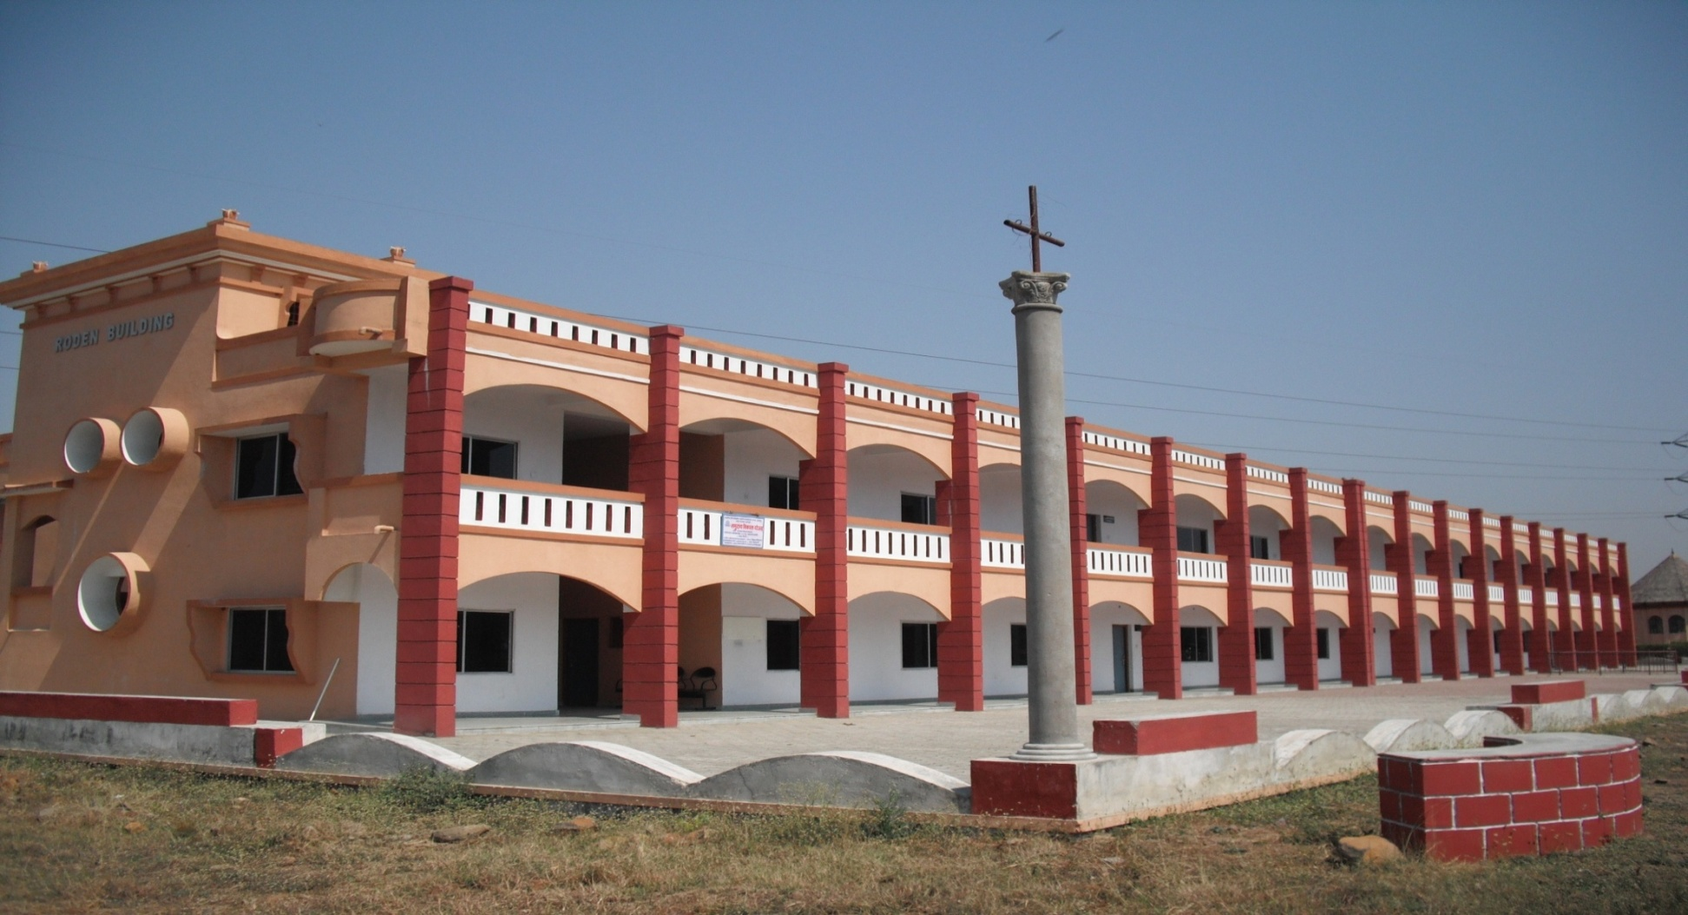
Mission India Institute for Vocational Training
Mission India Community College of Technology

Slide 2
What it is???
Mission India vocational training Institute is a non-profit venture with a deep realization of the urgent need of fulfilling the target and goal set by the Millennium Development Goals, Nutrition Policy and Skill Development Initiatives of India.
The basic motto of the Institute is to educate, train, and transform the marginalized community for employability and empowerment.
A holistic focus that takes into consideration all intricate and multi-dimensional factors. While imparting skills, it takes seriously the social, economic, psychological, environmental, and food & nutrition security.
A total nation building approach by being a change and change catalyst.

Slide 3
Vision
To establish self-sufficient villages through education and service, while considering global needs with promoting local talents.
To establish self-sustainable pastors or Church planters through the impartation of technical skills along with their theological education to be self-supportive in the ministries.

Slide 4
Mission
To march towards National and International targets and developmental goals through multi-dimensional curricula activities.
To break the vicious cycle of poverty and malnutrition by appropriate livelihood measures.
To preserve and promote traditional knowledge, values and rural talents.
To transfer technology, technical support service through awakening and awareness programs.

Slide 5
Objectives
To empower individuals through appropriate skill development leading to gainful employment in collaboration with the local industries, institutions, and community.
To reduce the mismatch between education and employability.
To minimize socio-economic inequality.
To establish social justice.
To establish gender equality.

Slide 6
Target Population
Theological/Missiological trainees
Street Children
School Drop Outs
Physically & Mentally Challenged
Destitute Women
Trans Gender
Jail Inmates
House wives
Unemployed

Slide 7
Affiliation
Affiliated with Indira Gandhi National Open University (IGNOU), New Delhi.
Incorporated with Indian Society for Technical Education, New Delhi.

Slide 8
Community-Based Focus
Household level food and nutrition security, food safety measures, promotion of local and traditional knowledge in nutrition.
Establishing nutrition garden in every household.
Update program for Anganwadi workers.
Solar system in every household through transfer of technology.
Promoting mud refrigerator and bamboo articles.
Promoting organic farming.
Promoting drugless therapy- Dietetics, SUJOK, Naturopathy & Yoga.

Slide 9
Description of Programs
Job oriented need based programs are designed and conducted to increase the employability (self/wage) and entrepreneurship.
Quality of the programs is ensured by the intervention of academic industrial experts.
The curriculum content of each program is time and again validated, approved and monitored by the Academic Committee and Institute Board.

Slide 10
Ongoing Programs
S.No. | Programs | Duration |  | Eligibility
A. Certificate Programs
1 | Computer Courses |  | 3/6 months | 10th pass
2. | Tally & Accounting |  | 3/6 months | 10th Pass
3. | Functional & Spoken English |  | 3/6 months | 10th Pass
4. | Tailoring |  | 3/6 months | 8th Pass
5. | Montessori Teachers Training |  | 6 month | 10th Pass
6. | 2 & 4 Wheelers vehs Repairing & Serving |  | 6 months | 8th Pass
7. | Organic Farming |  | 6 months | 8th Pass
8. | Mobile Repairing Technician |  | 3 months | 8th Pass

Slide 11
Ongoing Programs (Continued)
B. Diploma Programs
9. | Welding | 1 year | 10th Pass
10. | Carpentry | 1 year | 10th Pass
11. | A/C & Refrigeration | 1 year | 10th Pass
12. | Electrical & House Wiring | 1 year | 10th Pass
13. | Early Childhood Care & Education | 1 year | 12th Pass
14. | Value Added Products from fruits & Vegetables | 1 year | 12th Pass

Slide 12
Curriculum Coverage
The curriculum coverage is unique and exhaustive for the overall development of the students with emphasis on three skills: Work skill, Life Coping skill, and Communication skill.
Need-based: In addition, awareness training programs on need of the hour, such as, Environmental issues, Disaster Preparedness & Management, and Intellectual Property Rights & Patency.

Slide 13
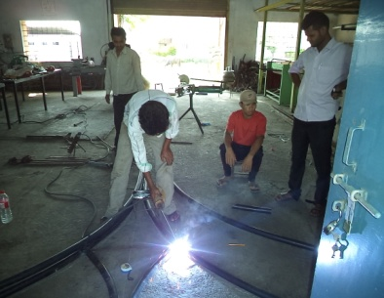
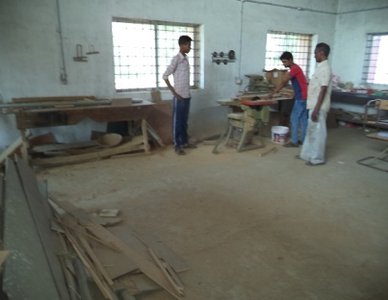
Activities
Mobile Repairing
Computer Education
Tailoring
Electrical
Welding
Carpentry

Slide 14
Vocational Options in the Slum
Programs Proposed | Target Population
Computer Education Montessori, Electrical Wiring Mobile Repairing, Entrepreneurship | Unemployed Adults
Basic Education Carpentry, Welding, Plumbing | Uneducated Adults
Entrepreneurship Computer Education, Tailoring Food Preservation, Crafts & Arts | House wives
Spoken English Computer Education | School Going Youth
Elementary Education | Unschooled Children

Slide 15
Budget
S. No. | Program | one year (Each Program) | Three years (Each Program)
1. | Computer Education/Montessori /Elementary Education/ Entrepreneurship/Spoken English | 10 hours/week 520 hours/year $ 2080 @ $ 4 per hr | $ 6240
2. | Electrical Wiring/Mobile Repairing/Tailoring | $ 2600 @ $ 5 per hr | $ 7800
3. | Carpentry/Welding/ Plumbing | $ 2600 @ $ 5 per hr | $ 7800
4. | Food Preservation/ Crafts & Arts | $ 1560 @ $ 3 per hr | $ 4680
5. | Program coordination & Maintenance (Internet & electricity ) | $ 4800 @ $ 400 per month | $ 14400
6. | House Rent | $ 2400 @ $ 200 per month | $ 7200

Slide 16
Budget for Equipments
S.No. | Items | Minimum requirements | Amount
1. | Computer | 05 | $ 2500
2. | Sewing Machines | 05 | $ 600
3. | Tools for carpentry, plumbing, etc. | --- | $ 500
4. | Tools for education | ---- | $ 100
 | Total |  | $ 3700

